Slide 1
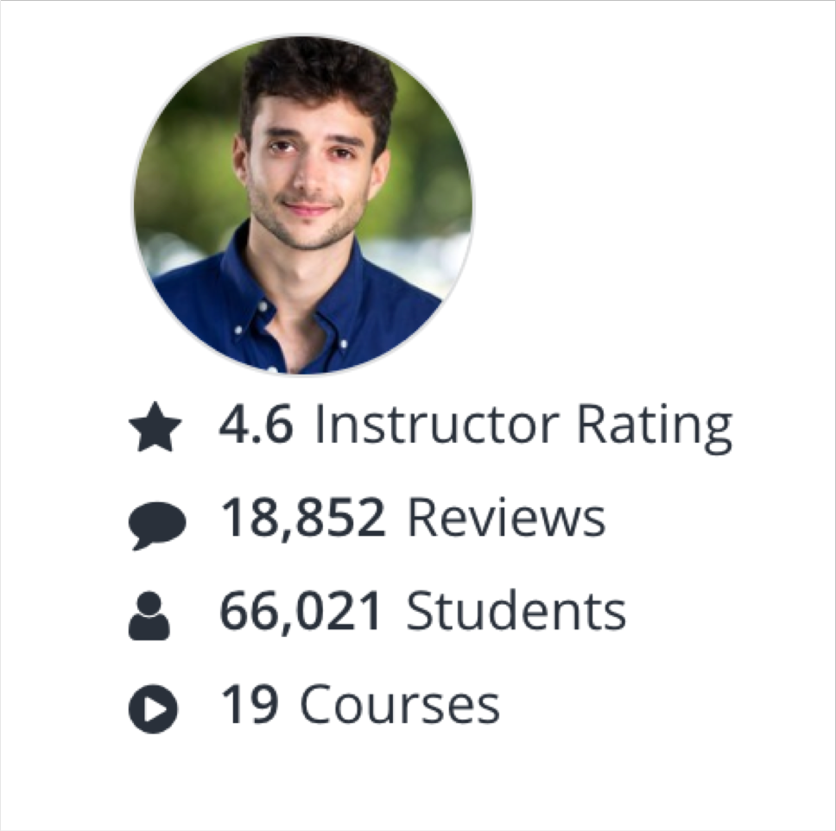
About me
NOT FOR DISTRIBUTION © Stephane Maarek www.datacumulus.com
I’m Stephane!
Working as in IT consultant and AWS Solutions Architect, Developer & SysOps
Worked with AWS many years: built websites, apps, streaming platforms
Veteran Instructor on AWS (Certifications, CloudFormation, Lambda, EC2…)
You can find me on
GitHub: https://github.com/simplesteph
LinkedIn: https://www.linkedin.com/in/stephanemaarek
Medium: https://medium.com/@stephane.maarek
Twitter: https://twitter.com/stephanemaarek
© Stephane Maarek

Slide 2


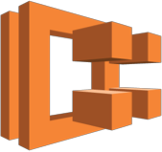



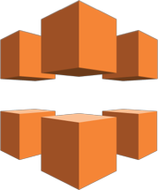
























What we’ll learn in this course (and more!)
NOT FOR DISTRIBUTION © Stephane Maarek www.datacumulus.com
Amazon EC2 | Amazon ECR | Amazon ECS | AWS Elastic | AWS | Elastic Load | Amazon | Amazon | Amazon | Amazon
 |  |  | Beanstalk | Lambda | Balancing | CloudFront | Kinesis | Route 53 | S3
Amazon RDS
Amazon DynamoDB
Amazon DynamoDB Accelerator
Amazon ElastiCache
Amazon SQS
Amazon SNS
AWS Step Functions
Amazon SWF
Amazon API Gateway
Amazon SES
Amazon Cognito
IAM
Amazon CloudWatch
Amazon EC2 Systems Manager
AWS
CloudFormation
AWS
CloudTrail
AWS
CodeCommit
AWS
CodeBuild
AWS
CodeDeploy
AWS
CodePipeline
AWS KMS
© Stephane Maarek

Slide 3
AWS Regions
NOT FOR DISTRIBUTION © Stephane Maarek www.datacumulus.com
AWS has regions all around the world (us-east-1)
Each region has availability zones (us- east-1a, us-east-1b…)
Each availability zone is a physical data center in the region, but separate from the other ones (so that they’re isolated from disasters)
AWS Consoles are region scoped (except IAM, S3 & Route53)
AWS Region (Sydney: ap-southeast-2)
ap-southeast-2a
ap-southeast-2b
ap-southeast-2c
© Stephane Maarek

Slide 4
Security Groups Good to know
NOT FOR DISTRIBUTION © Stephane Maarek www.datacumulus.com
Can be attached to multiple instances
Locked down to a region / VPC combination
Does live “outside” the EC2 – if traffic is blocked the EC2 instance won’t see it
It’s good to maintain one separate security group for SSH access
If your application is not accessible (time out), then it’s a security group issue
If your application gives a “connection refused“ error, then it’s an application error or it’s not launched
All inbound traffic is blocked by default
All outbound traffic is authorised by default
© Stephane Maarek

Slide 5
Elastic IPs
NOT FOR DISTRIBUTION © Stephane Maarek www.datacumulus.com
When you stop and then start an EC2 instance, it can change its public IP.
If you need to have a fixed public IP for your instance, you need an Elastic IP
An Elastic IP is a public IPv4 IP you own as long as you don’t delete it
You can attach it to one instance at a time
© Stephane Maarek

Slide 6
Elastic IP
NOT FOR DISTRIBUTION © Stephane Maarek www.datacumulus.com
With an Elastic IP address, you can mask the failure of an instance or software by rapidly remapping the address to another instance in your account.
You can only have 5 Elastic IP in your account (you can ask AWS to increase that).
Overall, try to avoid using Elastic IP:
They often reflect poor architectural decisions
Instead, use a random public IP and register a DNS name to it
Or, as we’ll see later, use a Load Balancer and don’t use a public IP
© Stephane Maarek

Slide 7
EC2 Instance Launch Types
NOT FOR DISTRIBUTION © Stephane Maarek www.datacumulus.com
On Demand Instances: short workload, predictable pricing
Reserved Instances: long workloads (>= 1 year)
Convertible Reserved Instances: long workloads with flexible instances
Scheduled Reserved Instances: launch within time window you reserve
Spot Instances: short workloads, for cheap, can lose instances
Dedicated Instances: no other customers will share your hardware
Dedicated Hosts: book an entire physical server, control instance placement
© Stephane Maarek

Slide 8
EC2 On Demand
NOT FOR DISTRIBUTION © Stephane Maarek www.datacumulus.com
Pay for what you use (billing per second, after the first minute)
Has the highest cost but no upfront payment
No long term commitment
Recommended for short-term and un-interrupted workloads, where you can't predict how the application will behave.
© Stephane Maarek

Slide 9
EC2 Reserved Instances
NOT FOR DISTRIBUTION © Stephane Maarek www.datacumulus.com
Up to 75% discount compared to On-demand
Pay upfront for what you use with long term commitment
Reservation period can be 1 or 3 years
Reserve a specific instance type
Recommended for steady state usage applications (think database)
Convertible Reserved Instance
can change the EC2 instance type
Up to 54% discount
Scheduled Reserved Instances
launch within time window you reserve
When you require a fraction of day / week / month
© Stephane Maarek

Slide 10
EC2 Spot Instances
NOT FOR DISTRIBUTION © Stephane Maarek www.datacumulus.com
Can get a discount of up to 90% compared to On-demand
You bid a price and get the instance as long as its under the price
Price varies based on offer and demand
Spot instances are reclaimed with a 2 minute notification warning when the spot price goes above your bid
Used for batch jobs, Big Data analysis, or workloads that are resilient to failures.
Not great for critical jobs or databases
© Stephane Maarek

Slide 11
EC2 Dedicated Hosts
NOT FOR DISTRIBUTION © Stephane Maarek www.datacumulus.com
Physical dedicated EC2 server for your use
Full control of EC2 Instance placement
Visibility into the underlying sockets / physical cores of the hardware
Allocated for your account for a 3 year period reservation
More expensive
Useful for software that have complicated licensing model (BYOL – Bring Your Own License)
Or for companies that have strong regulatory or compliance needs
© Stephane Maarek

Slide 12
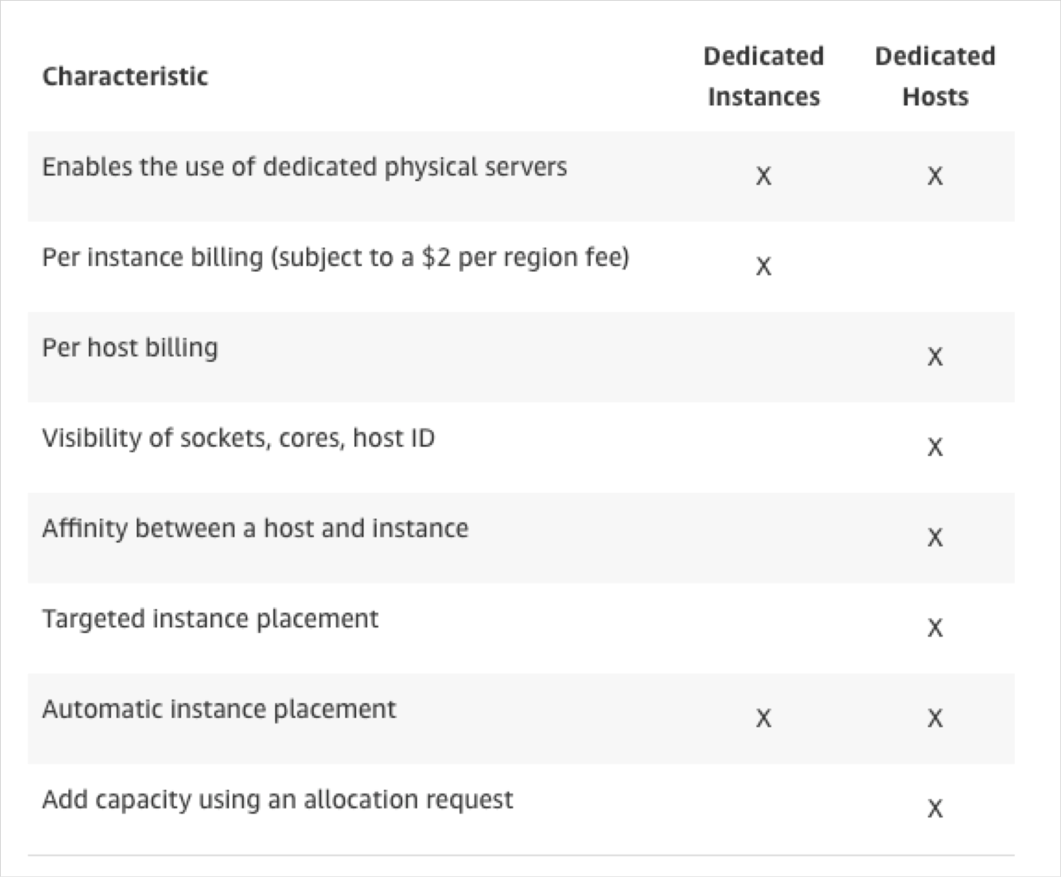
EC2 Dedicated Instances
NOT FOR DISTRIBUTION © Stephane Maarek www.datacumulus.com
Instances running on hardware that’s dedicated to you
May share hardware with other instances in same account
No control over instance placement (can move hardware after Stop / Start)
© Stephane Maarek

Slide 13

Which host is right for me?
NOT FOR DISTRIBUTION © Stephane Maarek www.datacumulus.com
On demand: coming and staying in resort whenever we like, we pay the full price
Reserved: like planning ahead and if we plan to stay for a long time, we may get a good discount.
Spot instances: the hotel allows people to bid for the empty rooms and the highest bidder keeps the rooms.You can get kicked out at any time
Dedicated Hosts: We book an entire building of the resort
© Stephane Maarek

Slide 14
EC2 Instance Types – Main ones
NOT FOR DISTRIBUTION © Stephane Maarek www.datacumulus.com
R: applications that needs a lot of RAM – in-memory caches
C: applications that needs good CPU – compute / databases
M: applications that are balanced (think “medium”) – general / web app
I: applications that need good local I/O (instance storage) – databases
G: applications that need a GPU – video rendering / machine learning
T2 / T3: burstable instances (up to a capacity)
T2 / T3 - unlimited: unlimited burst
Real-world tip: use https://www.ec2instances.info
© Stephane Maarek

Slide 15
Burstable Instances (T2/T3)
NOT FOR DISTRIBUTION © Stephane Maarek www.datacumulus.com
AWS has the concept of burstable instances (T2/T3 machines)
Burst means that overall, the instance has OK CPU performance.
When the machine needs to process something unexpected (a spike in load for example), it can burst, and CPU can be VERY good.
If the machine bursts, it utilizes “burst credits”
If all the credits are gone, the CPU becomes BAD
If the machine stops bursting, credits are accumulated over time
© Stephane Maarek

Slide 16
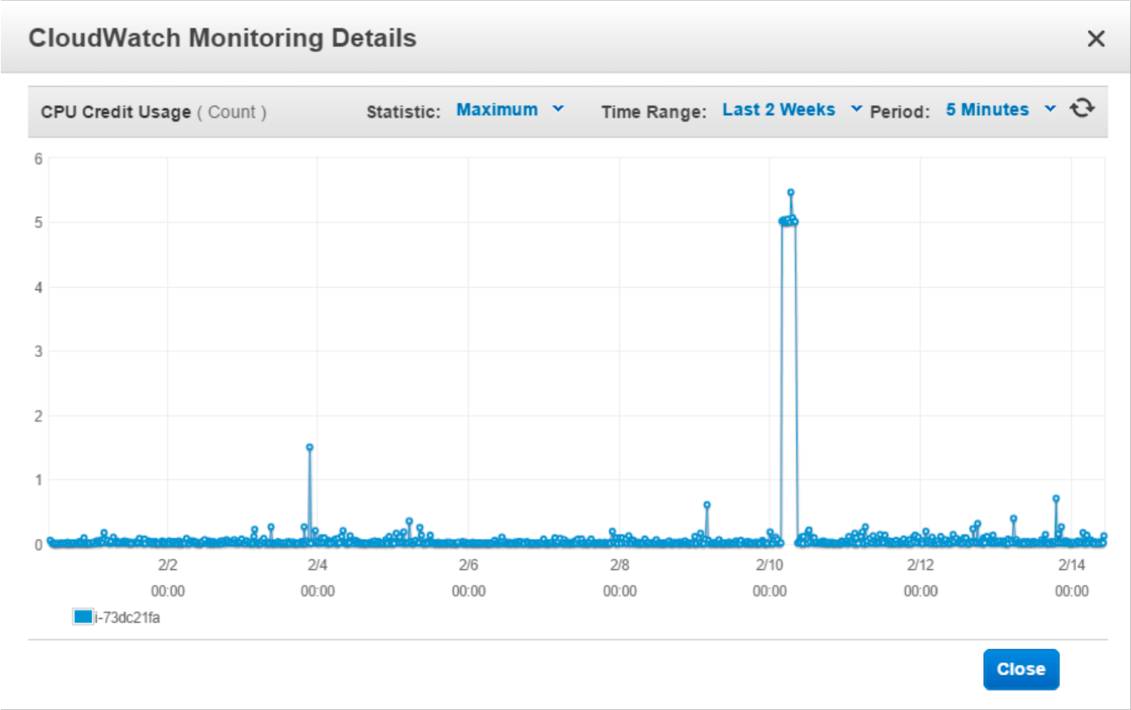
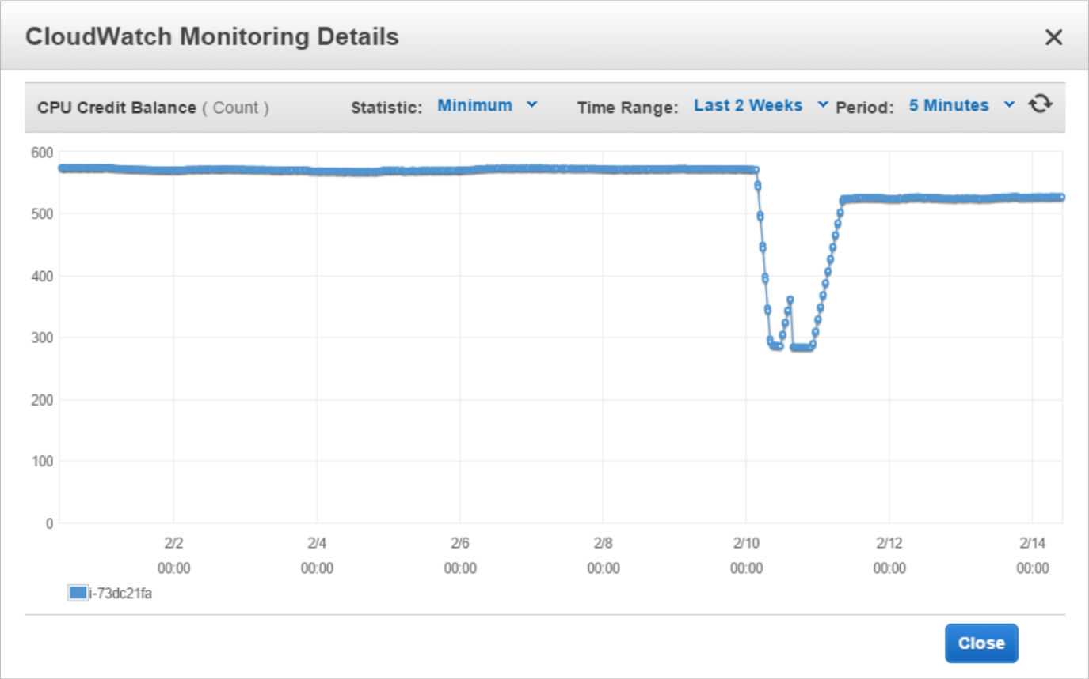
Burstable Instances (T2/T3)
NOT FOR DISTRIBUTION © Stephane Maarek www.datacumulus.com
Burstable instances can be amazing to handle unexpected traffic and getting the insurance that it will be handled correctly
If your instance consistently runs low on credit, you need to move to a different kind of non-burstable instance
Credit usage
Credit balance
© Stephane Maarek

Slide 17
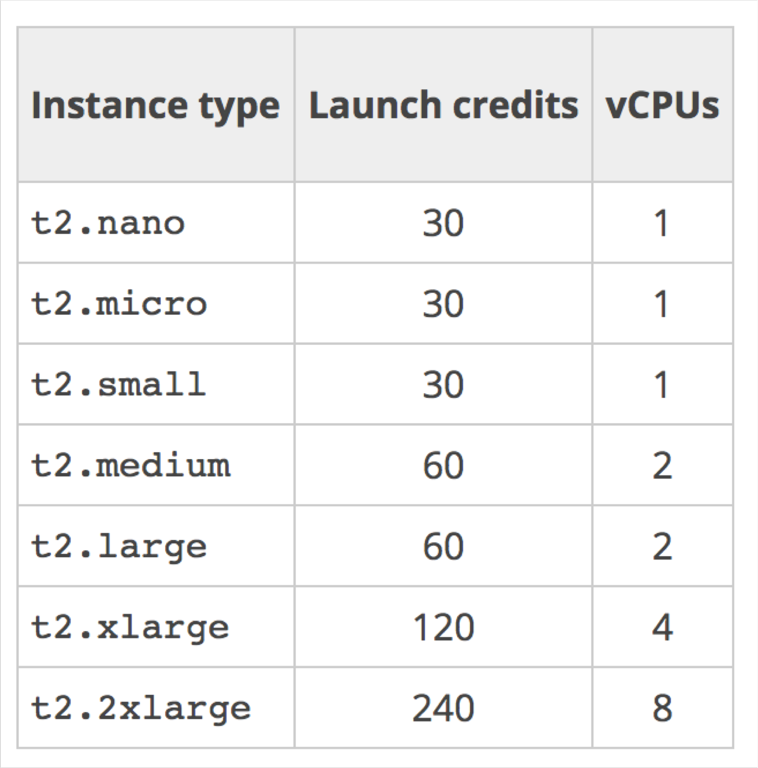
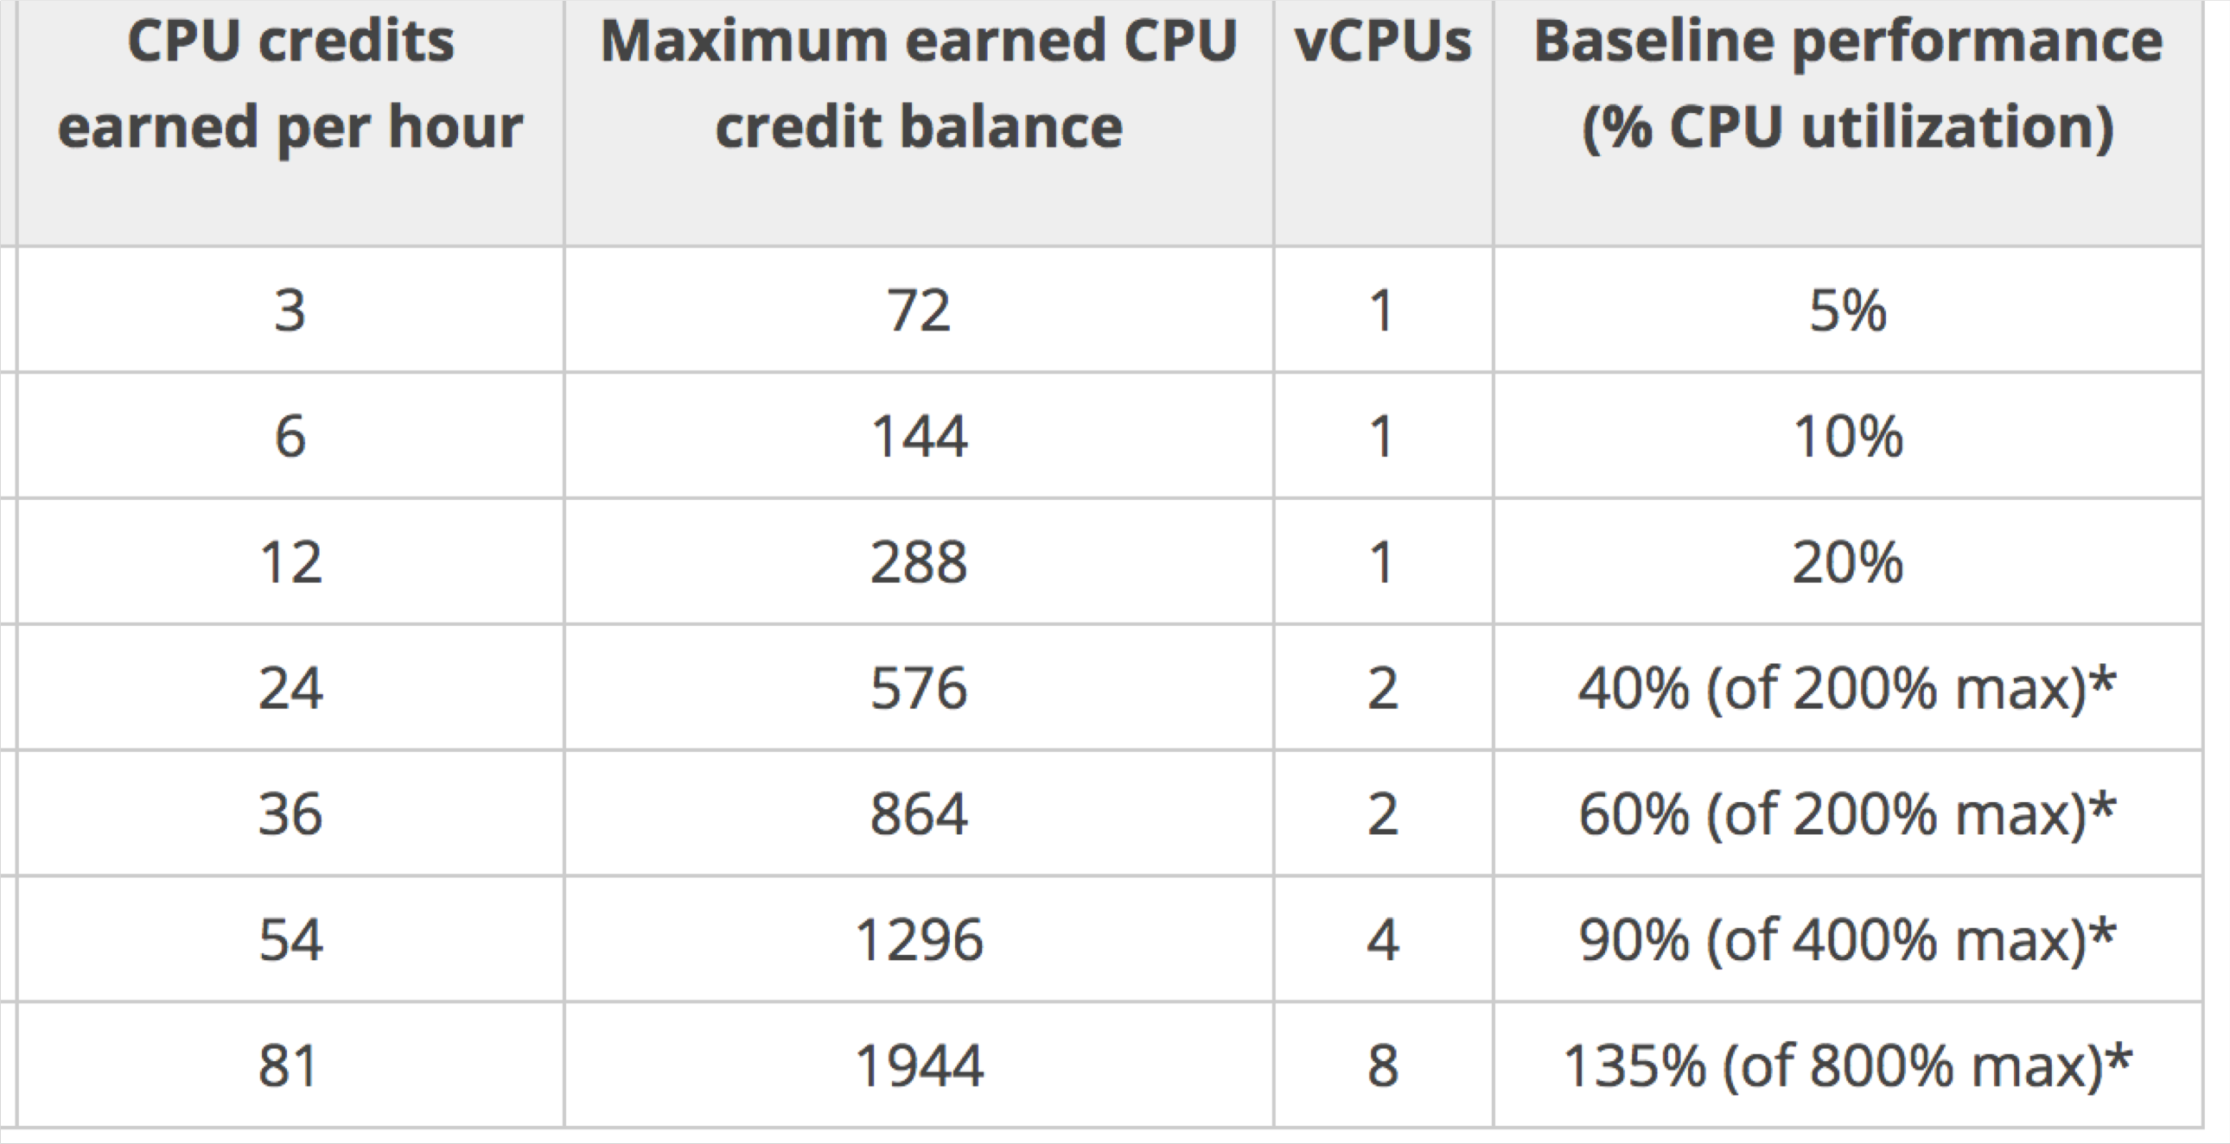
CPU Credits
NOT FOR DISTRIBUTION © Stephane Maarek www.datacumulus.com
© Stephane Maarek

Slide 18
AMI Pricing
NOT FOR DISTRIBUTION © Stephane Maarek www.datacumulus.com
AMIs live in Amazon S3, so you get charged for the actual space in takes in Amazon S3
Amazon S3 pricing in US-EAST-1:
First 50 TB / month: $0.023 per GB
Next 450 TB / month: $0.022 per GB
Overall it is quite inexpensive to store private AMIs.
Make sure to remove the AMIs you don’t use
© Stephane Maarek

Slide 19
Cross Account AMI Copy (FAQ + Exam Tip)
NOT FOR DISTRIBUTION © Stephane Maarek www.datacumulus.com
You can share an AMI with another AWS account.
Sharing an AMI does not affect the ownership of the AMI.
If you copy an AMI that has been shared with your account, you are the owner of the target AMI in your account.
To copy an AMI that was shared with you from another account, the owner of the source AMI must
grant you read permissions for the storage that backs the AMI, either the associated EBS snapshot (for an Amazon EBS-backed AMI) or an associated S3 bucket (for an instance store-backed AMI).
Limits:
You can't copy an encrypted AMI that was shared with you from another account. Instead, if the
underlying snapshot and encryption key were shared with you, you can copy the snapshot while re- encrypting it with a key of your own.You own the copied snapshot, and can register it as a new AMI.
You can't copy an AMI with an associated billingProduct code that was shared with you from another
account.This includes Windows AMIs and AMIs from the AWS Marketplace.To copy a shared AMI
with a billingProduct code, launch an EC2 instance in your account using the shared AMI and then create an AMI from the instance.
https://docs.aws.amazon.com/AWSEC2/latest/UserGuide/Copy ingAMIs.html
© Stephane Maarek

Slide 20
Placement Groups Cluster
NOT FOR DISTRIBUTION © Stephane Maarek www.datacumulus.com
EC2 |  |  | EC2 |  |  | EC2
EC2 |  |  | EC2 |  |  | EC2
Placement group Cluster
Low latency 10Gbps network
Same Rack Same AZ
Pros: Great network (10 Gbps bandwidth between instances)
Cons: If the rack fails, all instances fails at the same time
Use case:
Big Data job that needs to complete fast
Application that needs extremely low latency and high network throughput
© Stephane Maarek

Slide 21
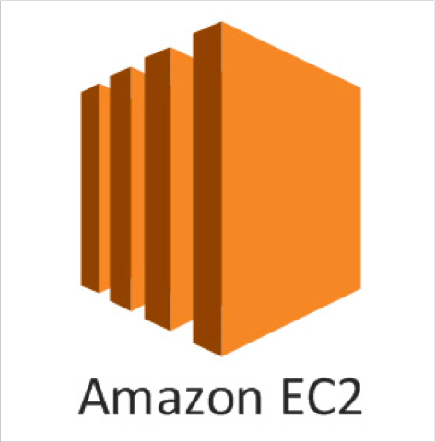
EC2 for Solutions Architects
NOT FOR DISTRIBUTION © Stephane Maarek www.datacumulus.com
EC2 instances are billed by the second, t2.micro is free tier
On Linux / Mac we use SSH, on Windows we use Putty
SSH is on port 22, lock down the security group to your IP
Timeout issues => Security groups issues
Permission issues on the SSH key => run “chmod 0400”
Security Groups can reference other Security Groups instead of IP ranges (very popular exam question)
Know the difference between Private, Public and Elastic IP
You can customize an EC2 instance at boot time using EC2 User Data
© Stephane Maarek

Slide 22
EC2 for Solutions Architects
NOT FOR DISTRIBUTION © Stephane Maarek www.datacumulus.com
Know the 4 EC2 launch modes:
On demand
Reserved
Spot instances
Dedicated Hosts
Know the basic instance types: R,C,M,I,G,T2/T3
You can create AMIs to pre-install software on your EC2 => faster boot
AMI can be copied across regions and accounts
EC2 instances can be started in placement groups:
Cluster
Spread
© Stephane Maarek

